Slide 1
개발 tool (Git / ANAcoda / VSC)
SW 개발 Tool 소개 및 환경 setup

Slide 2
개발 환경 Setup
학습 목표 - Software 개발 Tool을 설치하고 다루는 방법을 소개 - IDE(Integrated Development Environments) 환경에서 개발 및 디버깅 방법 습득 - 가상환경
학습 내용 - Git 설치 및 Version Control - 아나콘다 환경 설치 - VSC 설치 및 사용방법
출처 : http://git-scm.com/book/en/ http://www.cs.washington.edu/390a/

Slide 3
Basic Intro to Git
We will:
Discuss how Git differs from Subversion
Discuss the basic Git model
Pull/clone files from a repository on github
Edit files in your own local Git repo
Push files to a repo on github

Slide 4
Git Resources
At the command line: (where verb = config, add, commit, etc.)
$ git help <verb>
$ git <verb> --help
$ man git-<verb>
Free on-line book: http://git-scm.com/book
Git website: http://git-scm.com/

Slide 5
Git History
Came out of Linux development community
Linus Torvalds, 2005
Initial goals:
Speed
Support for non-linear development (thousands of parallel branches)
Fully distributed
Able to handle large projects like Linux efficiently

Slide 6

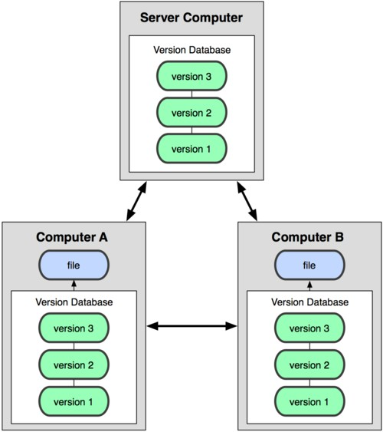
Git uses a distributed model
Centralized Model
Distributed Model
(CVS, Subversion, Perforce)
(Git, Mercurial)
Result: Many operations are local

Slide 7
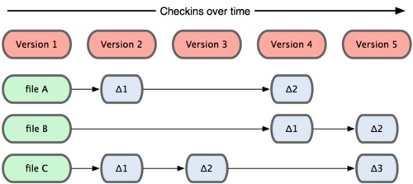
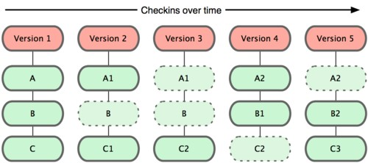
Git takes snapshots
Subversion
Git

Slide 8
Git uses checksums
In Subversion each modification to the central repo incremented the version # of the overall repo.
How will this numbering scheme work when each user has their own copy of the repo, and commits changes to their local copy of the repo before pushing to the central server?????
Instead, Git generates a unique SHA-1 hash – 40 character string of hex digits, for every commit. Refer to commits by this ID rather than a version number. Often we only see the first 7 characters:
1677b2d Edited first line of readme
258efa7 Added line to readme
0e52da7 Initial commit

Slide 9

A Local Git project has three areas
Unmodified/modified Files
Staged Files
Committed Files
Note: working directory sometimes called the “working tree”, staging area sometimes called the “index”.

Slide 10
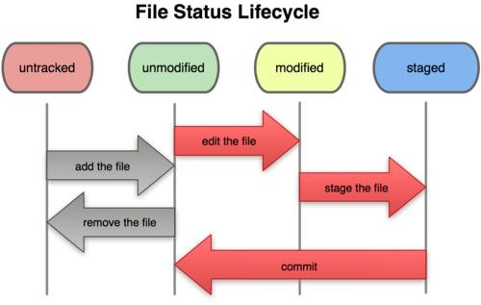
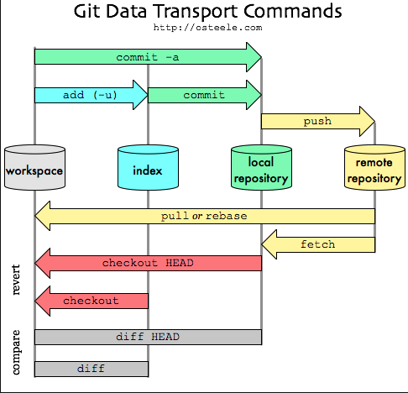
Git Life cycle

Slide 11
Basic Workflow
Basic Git workflow:
Modify files in your working directory.
Stage files, adding snapshots of them to your staging area.
Do a commit, which takes the files as they are in the staging area and stores that snapshot permanently to your Git directory
Notes:
If a particular version of a file is in the git directory, it’s considered committed.
If it’s modified but has been added to the staging area, it is staged.
If it was changed since it was checked out but has not been staged, it is modified.

Slide 12
what is github?
GitHub.com is a site for online storage of Git repositories.
Many open source projects use it, such as the Linux kernel.
You can get free space for open source projects or you can pay for private projects.
Question: Do I have to use github to use Git?
Answer: No!
you can use Git completely locally for your own purposes, or
you or someone else could set up a server to share files, or
you could share a repo with users on the same file system, such as we did for homework 9
(as long everyone has the needed file permissions).

Slide 13
Get ready to use Git!
1. Set the name and email for Git to use when you commit:
$ git config --global user.name “Bugs Bunny”
$ git config --global user.email bugs@gmail.com
You can call git config –list to verify these are set.
These will be set globally for all Git projects you work with.
You can also set variables on a project-only basis by not using the
--global flag.
You can also set the editor that is used for writing commit messages:
$ git config --global core.editor emacs (it is vim by default)

Slide 14
Create a local copy of a repo
Two common scenarios: (only do one of these)
To clone an already existing repo to your current directory:
$ git clone <url> [local dir name]
This will create a directory named local dir name, containing a working copy of the files from the repo, and a .git directory (used to hold the staging area and your actual repo)
To create a Git repo in your current directory:
$ git init
This will create a .git directory in your current directory. Then you can commit files in that directory into the repo:
$ git add file1.java
$ git commit –m “initial project version”

Slide 15
Git commands
command | description
git clone url [dir] | copy a git repository so you can add to it
git add files | adds file contents to the staging area
git commit | records a snapshot of the staging area
git status | view the status of your files in the working directory and staging area
git diff | shows diff of what is staged and what is modified but unstaged
git help [command] | get help info about a particular command
git pull | fetch from a remote repo and try to merge into the current branch
git push | push your new branches and data to a remote repository
others: init, reset, branch, checkout, merge, log, tag

Slide 16
Committing files
The first time we ask a file to be tracked, and every time before we commit a file we must add it to the staging area:
$ git add README.txt hello.java
This takes a snapshot of these files at this point in time and adds it to the staging area.
$ vim .ignore This will make the file as untrack
To move staged changes into the repo we commit:
$ git commit –m “Fixing bug #22”
Note: To unstage a change on a file before you have committed it:
$ git reset HEAD -- filename
Note: To unmodify a modified file:
$ git checkout -- filename
Note: These commands are just acting on your local version of repo.

Slide 17
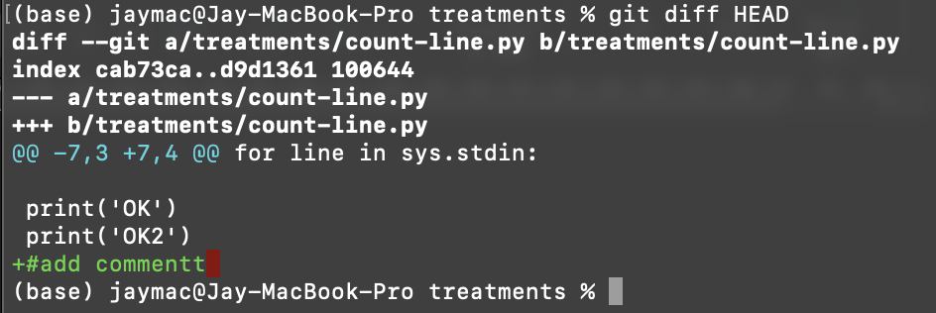
Status and Diff
To view the status of your files in the working directory and staging area:
$ git status or
$ git status –s (-s shows a short one line version similar to svn)
diff information $ git diff # Working Directory와 Staging Area 사이의 차이
--- a/count-line.py 변경전 파일
+++ b/count-line.py 변경후 파일
-7, 3 //7번째 포함 3라인은 변경전 파일
+7, 4 //7번째 포함 4라인에서 부터 변경 됨

Slide 18
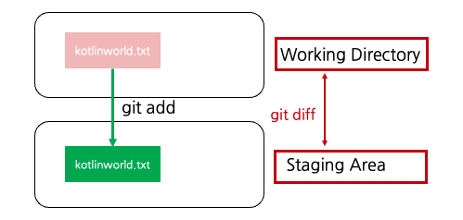
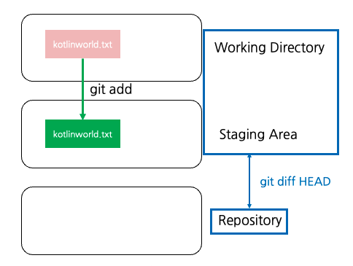
Status and Diff
diff information
To see what is modified but unstaged:
$ git diff # Working Directory와 Staging Area 사이의 차이 $ git diff HEAD #Working Director and Staging 을 Repository HEAD commit에 대한 차이
출처 https://kotlinworld.com/

Slide 19
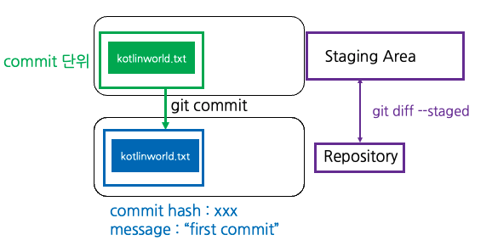
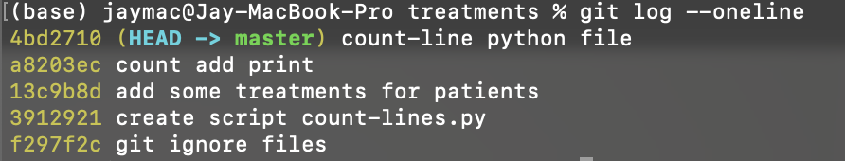
Status and Diff
To see what is modified but unstaged:
$ git diff --staged # Staging Area와 Repository사이의 차이
To see other changes:
$ git diff [option] [file name] //ex git diff --staged filename $ git diff [branch1]..[branch2] //branch간 비교 $ git diff [commit1 hash]..[commit2 hash] //commit간 비교
※ Hash code 는 git log --oneline 을 통해 얻을 수 있음
출처 https://kotlinworld.com/

Slide 20
Viewing logs
To see a log of all changes in your local repo:
$git log or
$git log --oneline (to show a shorter version)
1677b2d Edited first line of readme 258efa7 Added line to readme 0e52da7 Initial commit
$git log -5 (to show only the 5 most recent updates, etc.)
Note: changes will be listed by commitID #, (SHA-1 hash)
Note: changes made to the remote repo before the last time you cloned/pulled from it will also be included here

Slide 21
Pulling and Pushing
Add and Commit your changes to your local repo
Pull from remote repo to get most recent changes (fix conflicts if necessary, add and commit them to your local repo)
Push your changes to the remote repo
To fetch the most recent updates from the remote repo into your
local repo, and put them into your working directory:
$ git pull origin master
To push your changes from your local repo to the remote repo:
$ git push origin master
Note: origin = an alias for the URL you cloned from
master = the remote branch you are pulling from/pushing to,
(the local branch you are pulling to/pushing from is your current branch)

Slide 22
Branching
To create a branch called experimental:
$ git branch experimental
To list all branches: (* shows which one you are currently on)
$ git branch
To switch to the experimental branch:
$ git checkout experimental
Later on, changes between the two branches differ, to merge changes from experimental into the master:
$ git checkout master
$ git merge experimental
Note: git log --graph can be useful for showing branches. Note: These branches are in your local repo!

Slide 23
SVN vs. Git
SVN:
central repository approach – the main repository is the only “true”
source, only the main repository has the complete file history
Users check out local copies of the current version
Git:
Distributed repository approach – every checkout of the repository is a full fledged repository, complete with history
Greater redundancy and speed
Branching and merging repositories is more heavily used as a result

Slide 24
Do This:
$ git config --global user.name “Your Name”
$ git config --global user.email youremail@whatever.com
$ git clone https://github.com/rea2000/santalist.git
Then try:
$ git log, $ git log --oneline
Create a file named userID.txt (e.g. rea.txt)
$ git status, $ git status –s
Add the file: $ git add userID.txt
$ git status, $ git status –s

Slide 25
Anacoda
아나콘다는 가상의 개발환경을 만들어 주는 것.예로 가상 머신에서 돌아가는 자바처럼 파이썬의 다양한 Package를 Import 해서 사용할 수 있도록 개발 환경을 꾸며주는 것
왜 아나콘다를 사용해야 하는 것인가?
각 Package 버전 충돌을 방지하고 Python의 버전(2.x or 3.x)에 따른 개발 환경을 바꾸기 위해 가상환경을 제공하는 아나콘다가 필요함
프로젝트별로 필요한 Package만 설치하여 개발 환경 구성이 가능

Slide 26
Anacoda
첫째 상업용 무료로 사용할 수 있음
둘째 다양한 패키지를 이미 내포
셋째 주피터 노트북을 이용할 수 있음
넷째 프로젝트 개별적으로 패키지를 다르게 관리 가능

Slide 27
Anacoda 설치
아나콘다 Download
Anaconda를 설치하셨으면, 터미널에서 conda라는 명령어를 통해 가상환경을 만들고, 패키지 관리가 가능
설치된 리스트 확인 conda list
Package 설치 conda install pandas //단일 package conda install pandas numpy tensorflow //multi package
Upgrade conda update pandas
Package 제거
conda remove pandas

Slide 28
Anacoda 설치
설치된 package 검색 conda searh ‘*pandas*’
가상환경 생성 conda create –n my_python_env36
가상환경에서의 추가 패키지 인스톨 conda create –n my_python_env36 pandas tensorflow
가상환경 시작 및 종료 activate my_python_env36 deactivate my_python_env36
가상환경 저장 conda env export > my_python_env36.yaml conda evn create –f my_python_env36.yaml
가상환경 list 출력 conda env list

Slide 29
Anacoda 설치
가상환경 제거 하기 conda env remove –n my_python_evn36
추가 application 설치 하기 conda install jupyter notebook //Jupyter notebook는 브라우져 상에서 markdown, text, code, 시각화등등 다양한 기능을 할 수 있도록 지원 conda install nb_conda //jupyter notebook에서 python 패키지를 관리

Slide 30
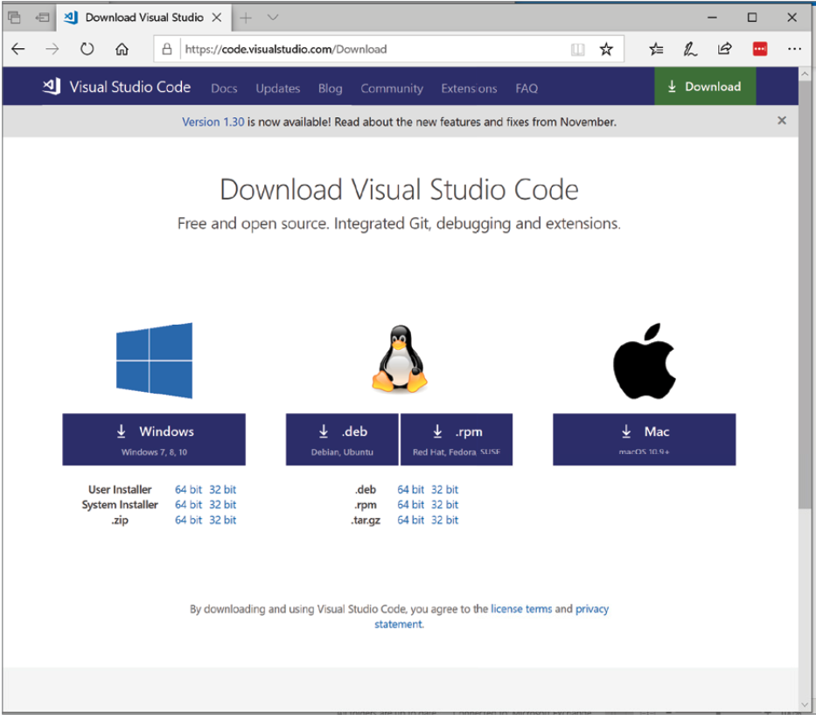
VSC Installing
Download: https://code.visualstudio.com/Download

Slide 31
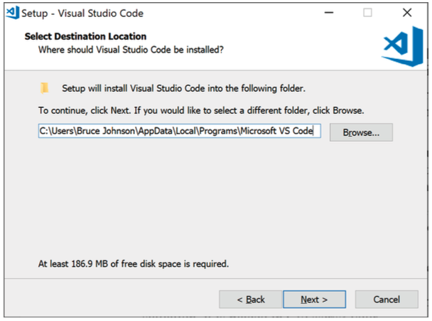
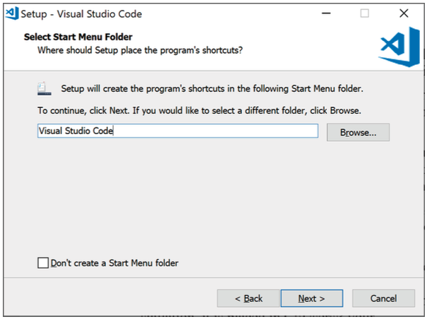
VSC Installing
Destination Location
Start Menu Folder

Slide 32
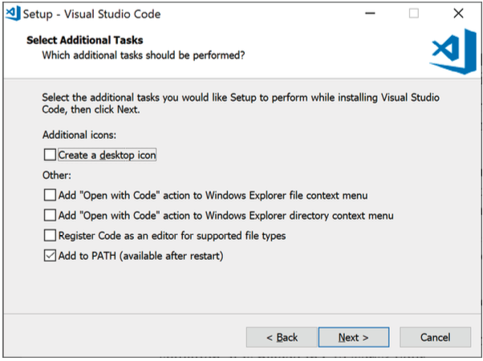
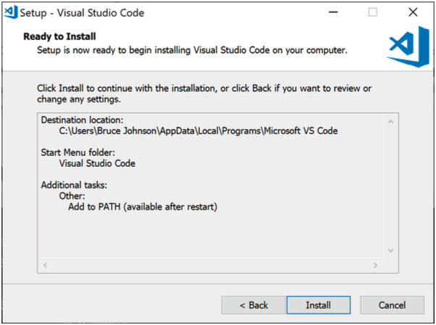
VSC Installing
Setup PATH environment
Install

Slide 33
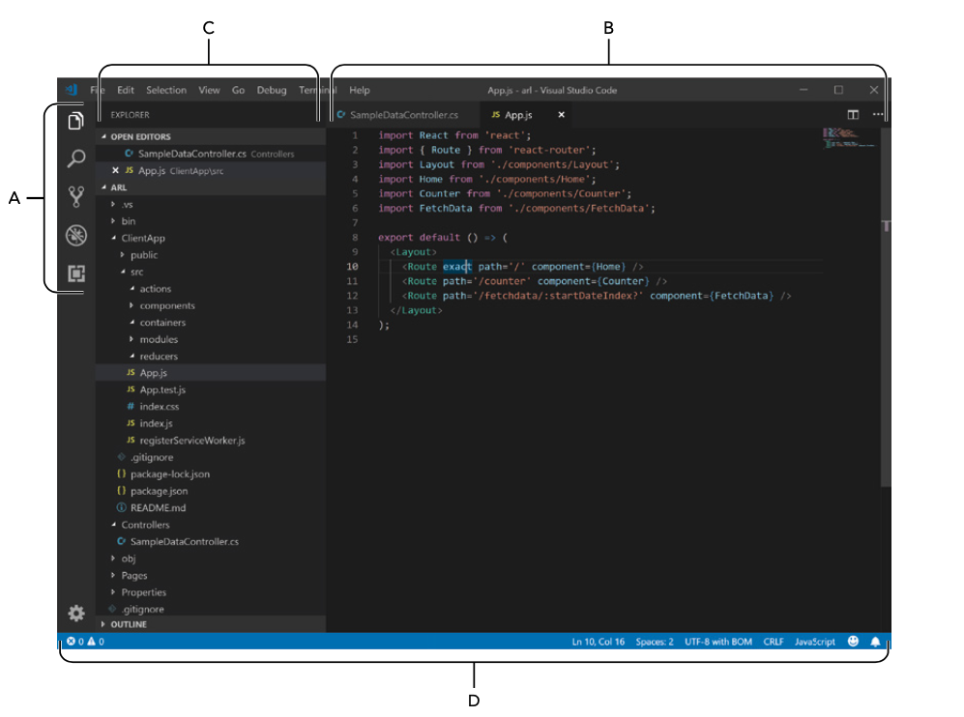
VSC Interface
A(active bar): switch different view
B(editor): multiple editor
C(work space): source code control
D(display information): current active workspace

Slide 34
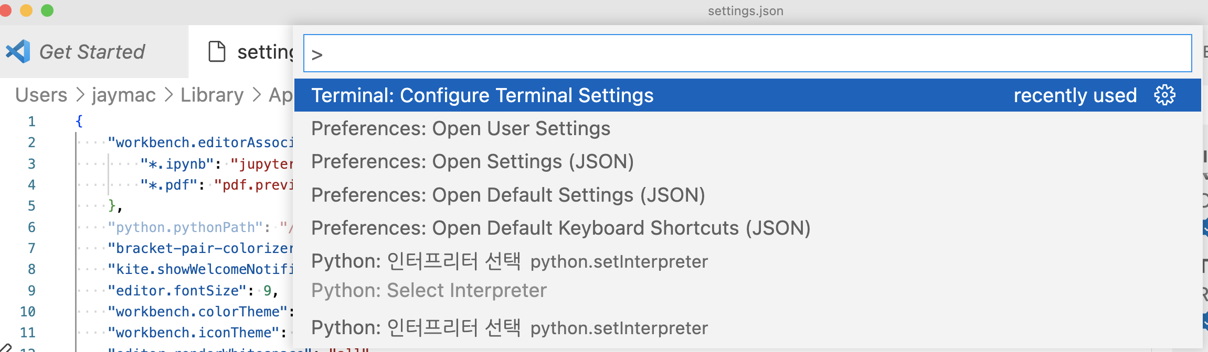
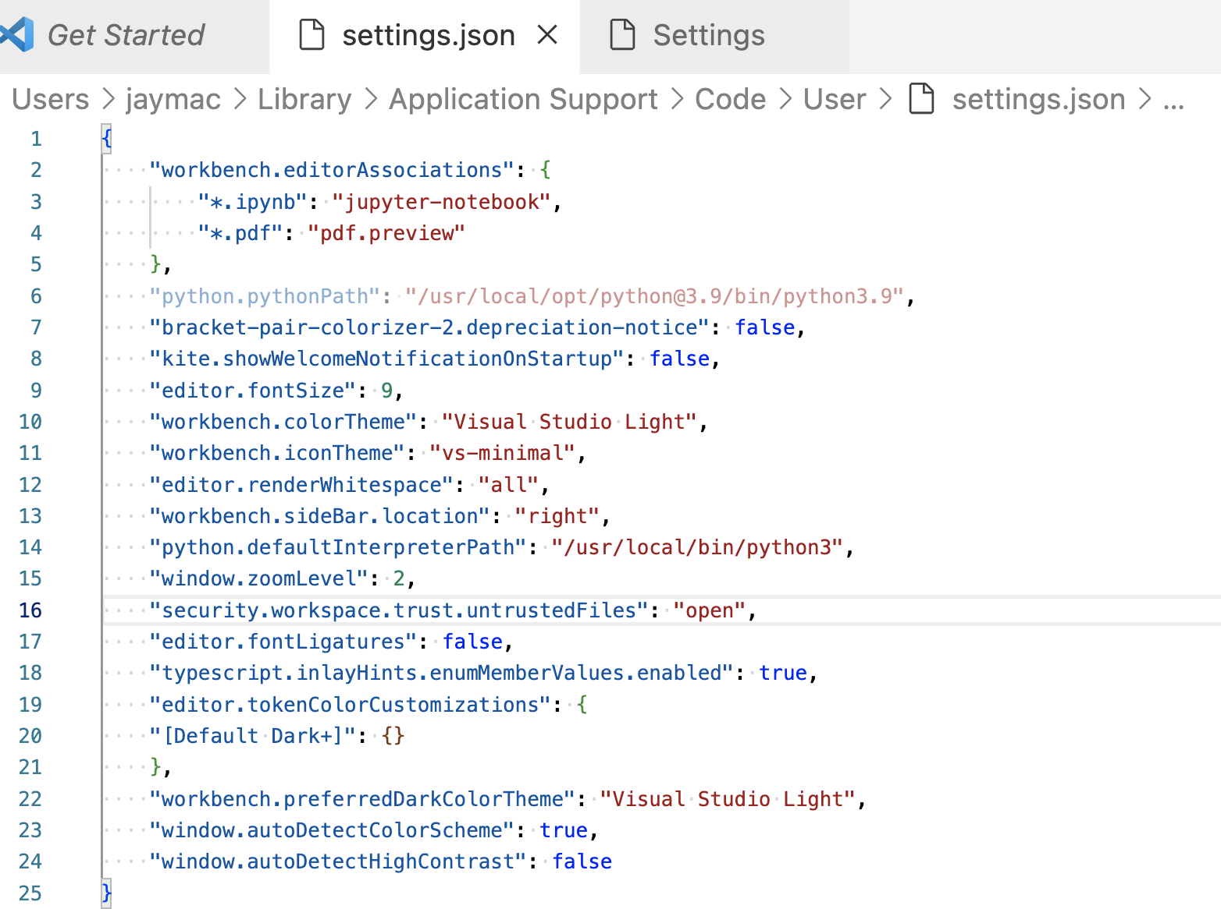
Command pallette
Ctrl‐Shift+P (Cmd+Shift+P in macOS) setting: keyboard, and navigation
JSON setting Change setting value

Slide 35
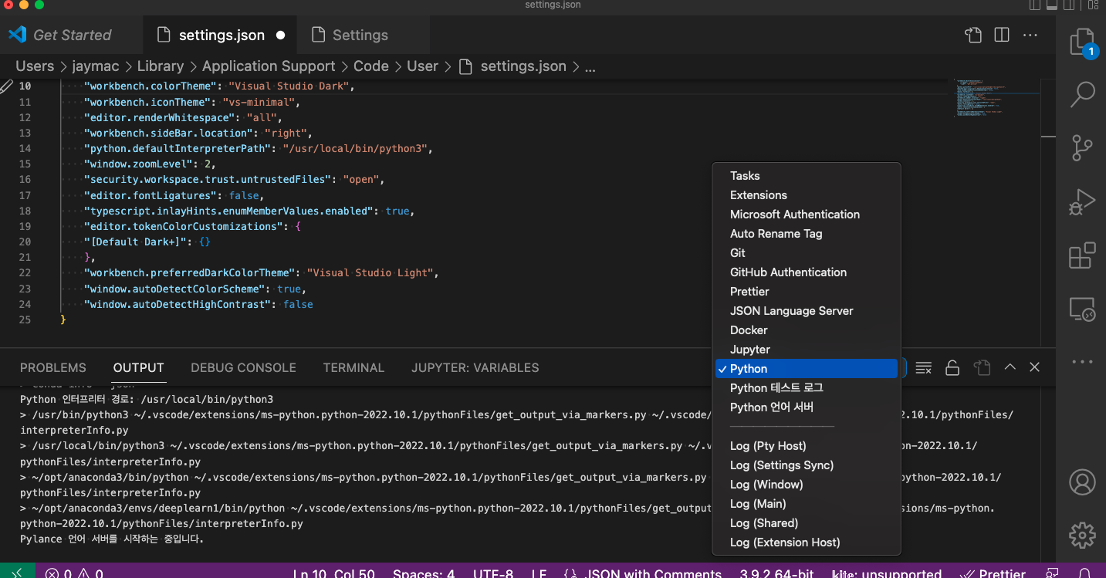
Window
Terminal: - execute commands from the command line - use terminal menu options
Output Window - display output from different processes
Debug Console - display messages which are debugged by application
Problem Window - lists all the errors and warning currently founded

Slide 36
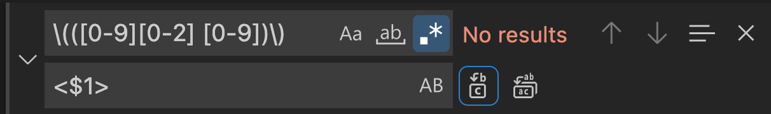
Search and replace
Search Ctrl + F
Replace - activate regex icon white box - detail information: http://aka.ms/regex - To test your regular expressions, see http://regexlib.com/RETester.aspx
ex) (3) (4) (5)로 된 숫자를 찾아서 <3> <4><5> 로바꾸자
Find \(([0-9])\)
Replace <$1> //

